Slide 1
All YTRC Network Traffic
MIS DEPARTMENT

Slide 2


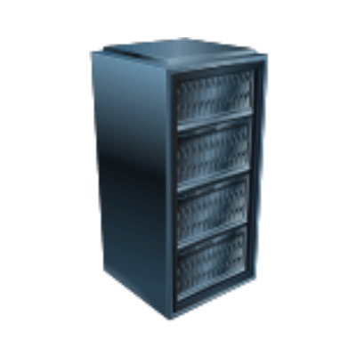

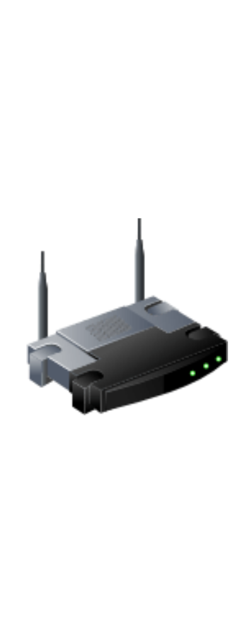








All network traffic is centralized and inspected by the firewall to enforce security policies.
Internet Main
Internet Backup
VM Server 13 Unit
Factory
Firewall
Office
CCTV 131 Unit
PLC for control and Sensor 100 Unit
Internet for Operator Resident 200 Unit
Internet for Staff Resident 50 Unit
Mobile 20 Unit
Computer 75 Unit
Printer 10 Unit

